Slide 1
Fraud Detection in Insurance Claims
IE 7275 - Data Mining in Engineering
Group 17
Gavin Dsa
Rohith Kumar Manjunatha

Slide 2
Table of Contents
Problem Setting 3
Problem Definition 4
Data Source 5
Data Description 6
Data Exploration 7
Data Preprocessing 9
Data Model Exploration 10
Model Selection 17
Project Results 18

Slide 3
Problem Setting
The U.S faces insurance fraud of about $80 billion every year and we are trying to investigate what kind of factors are important while predicting insurance fraud.
This would help insurance companies since they wouldn't need to investigate every single incident and only spend time and money on the ones that are more likely to be frauds.
In this dataset, machine learning techniques for fraud detection are presented and their performance is examined.

Slide 4
Problem Definition
The aim of this project is to build a model that detects insurance frauds and thus reduces the fraud investigation costs to help insurance companies.
We are building a classification model to tell us whether the incident is more likely to be a fraud or not.

Slide 5
Data Source
Kaggle
https://www.kaggle.com/roshansharma/fraud-detection-in-insurance-claims/data

Slide 6
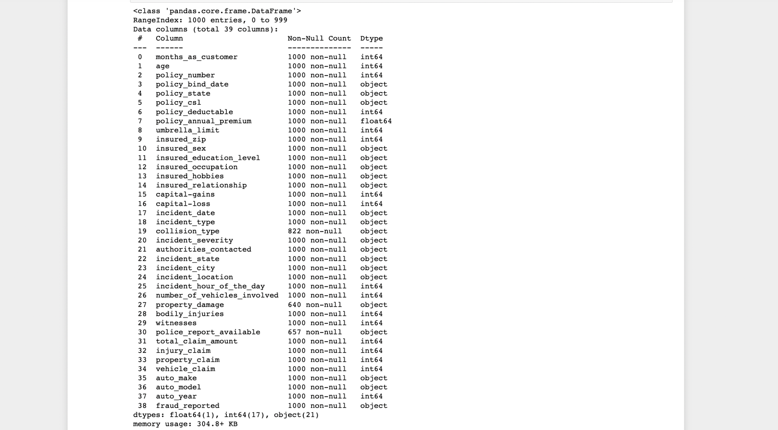
Data Description
The data contains about 1000 rows and 39 columns with key attributes such as Age, Annual premium, policy deductible, umbrella limit, insured occupation, capital gains, capital loss, incident type, collision type, incident severity, witnesses, etc.
Target variable (Y): Fraud reported (Yes/No)

Slide 7
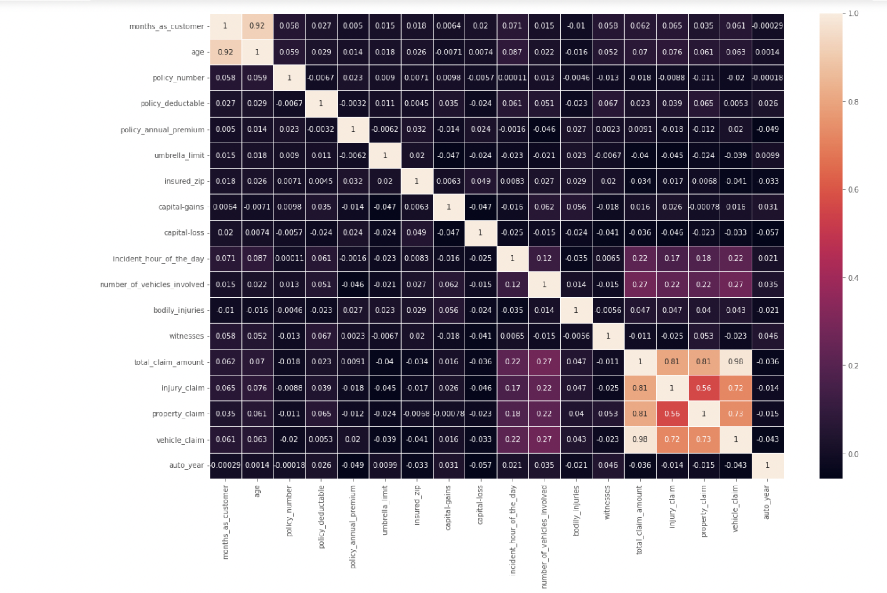
Data Exploration
Correlation Plot:
From this plot we can see that months_as_customers and age are highly correlated, so we can drop the ‘Age’ column.
Similarly, even total_clam_amount, injury_claim, property_claim, vehicle_claim are highly correlated and total claim is the sum of the other claims. Hence we can drop that column too.

Slide 8
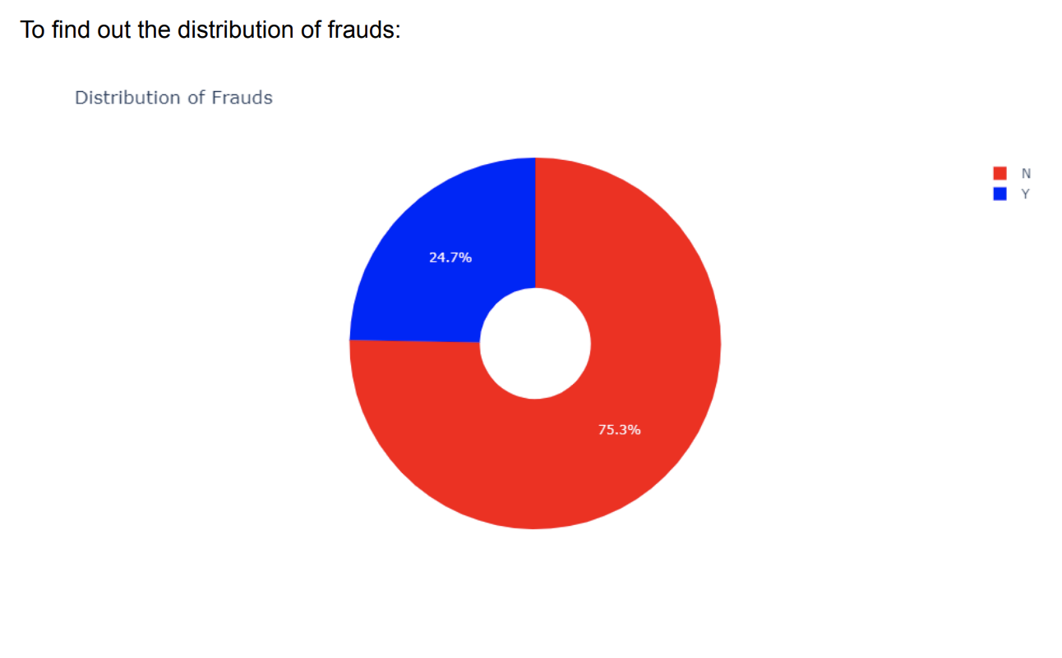
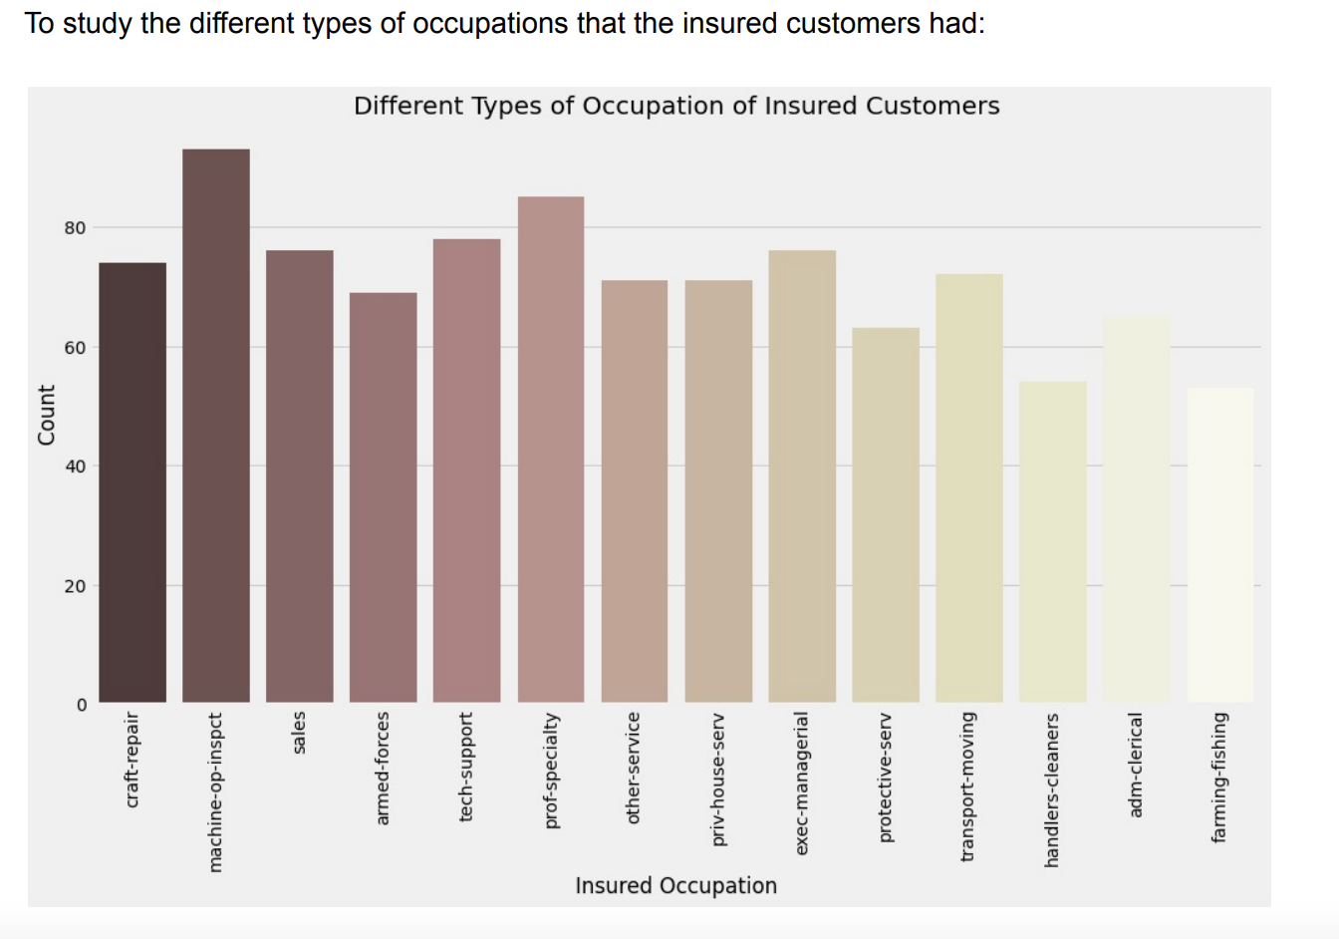
Data Exploration

Slide 9
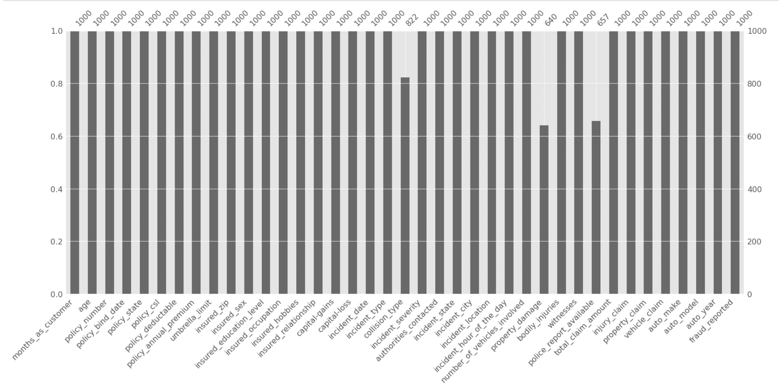
Data Pre-processing
Since the dataset had some ‘?’ values, we have replaced them with ‘NaN’ values.
We have also replaced the ‘?’ values in collision type with the mode values(Since it occurs the most).
We have replaced ‘Property_damage’ with the response ‘No’ wherever it is not available because the lack of a response is more likely to be in the case of no property damage. For the same reason, we have also filled ‘Police_report_available’ values with ‘No’ wherever it's not available.

Slide 10
Model Exploration
We split the dataset into 75% training set and 25% test set.
The following models were used:
Random Forest
K - Nearest Neighbors
Support Vector Machine
Decision Tree

Slide 11
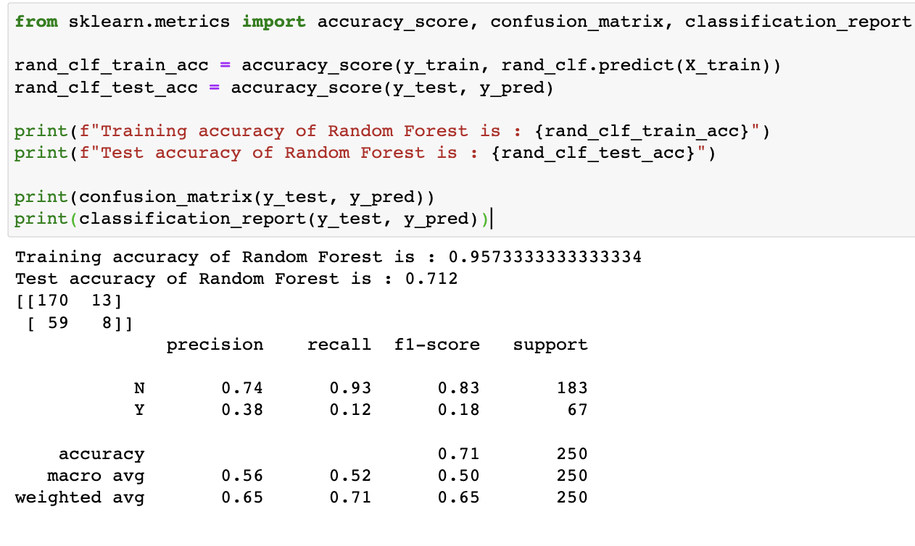
Random Forest
Accuracy is 0.71

Slide 12
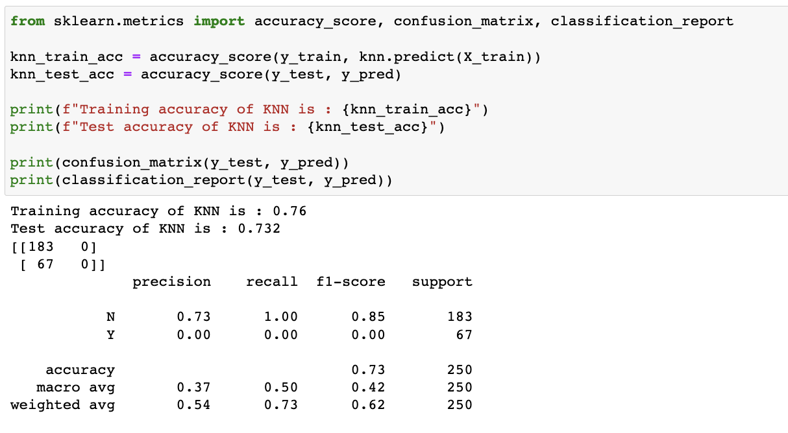
K-Nearest Neighbors
Accuracy is 0.73

Slide 13
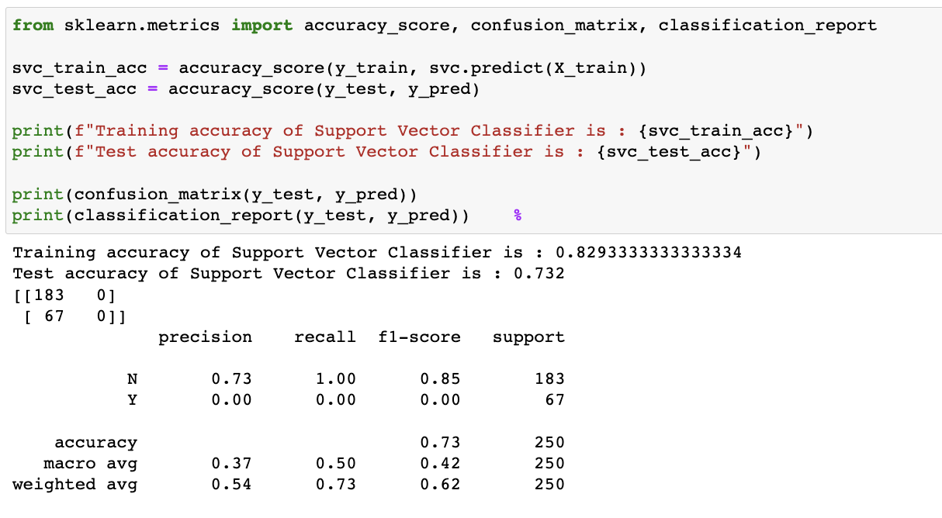
Support Vector Machine
Accuracy is 0.73

Slide 14
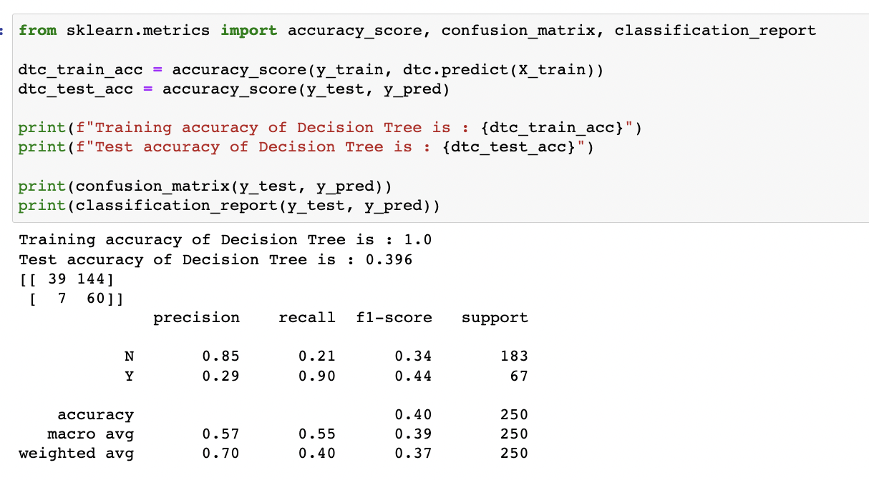
Decision Tree
Accuracy is 0.4

Slide 15
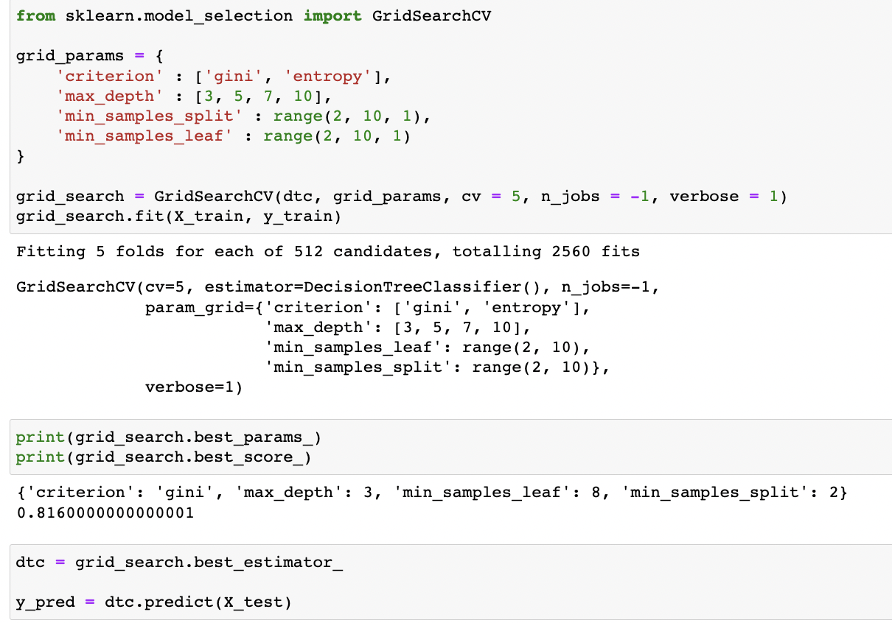
Decision Tree (Hyper Parameter Tuning)
Used grid search in order to find the best hyper parameters for our decision tree.
Using this, we get an improved accuracy for our model.

Slide 16
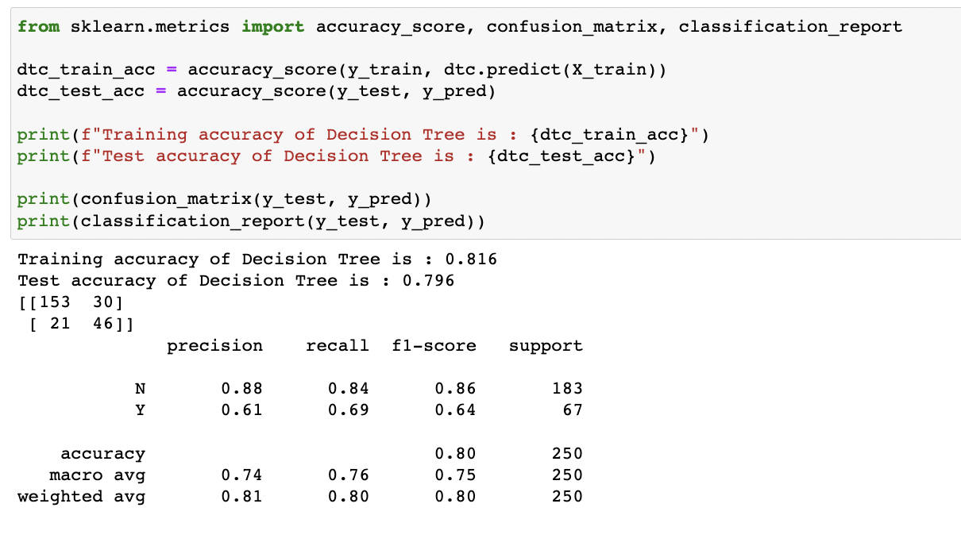
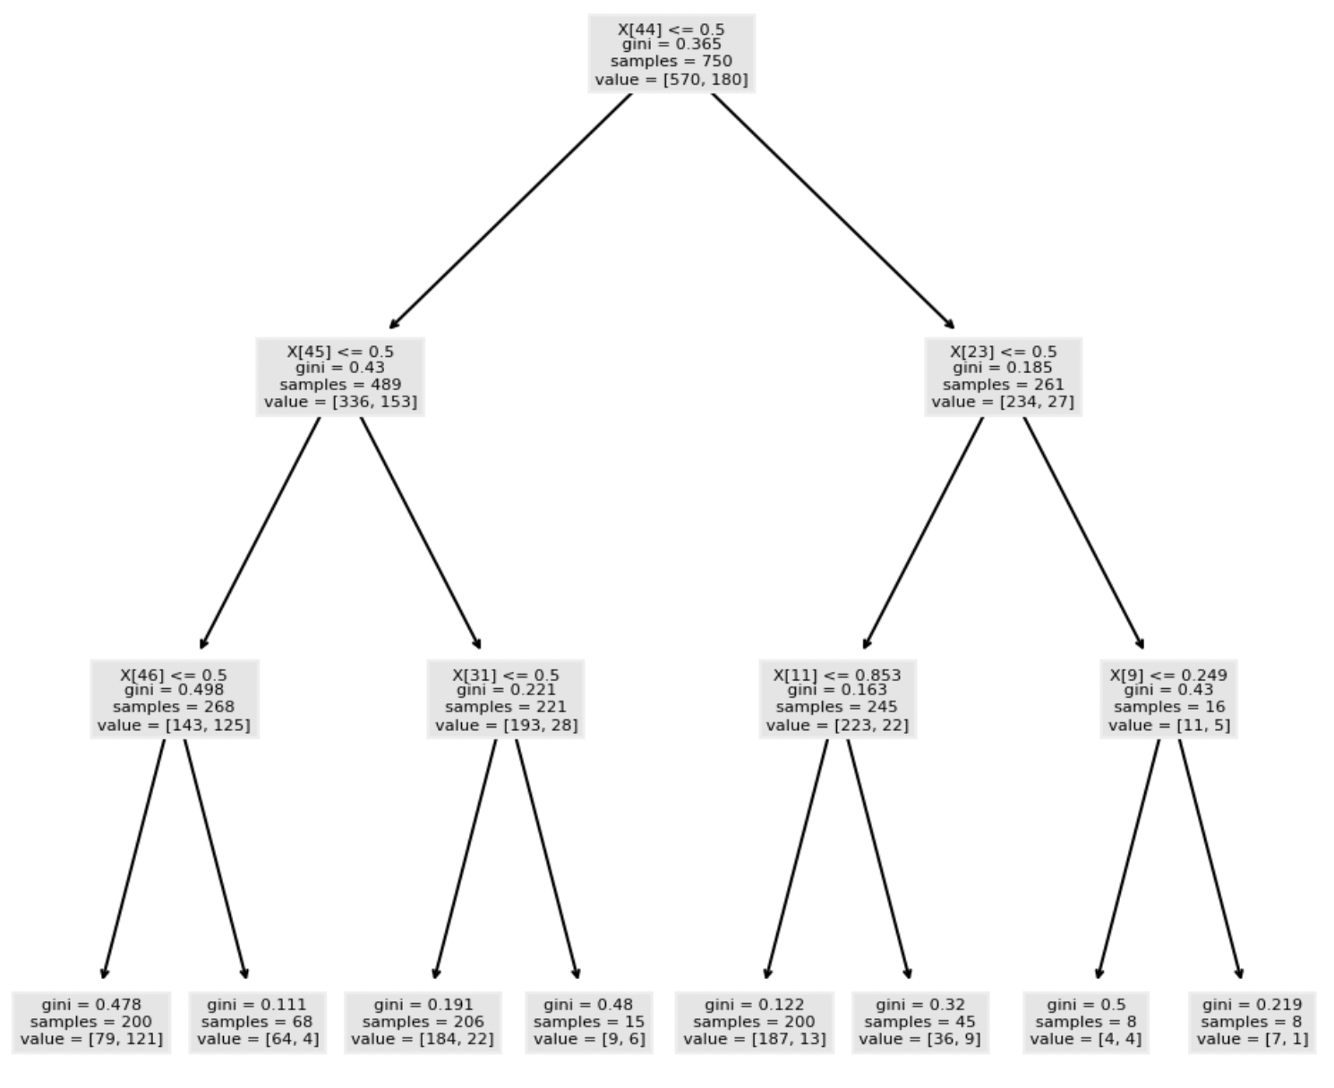
Decision Tree (Hyper Parameter Tuning)
Accuracy is 0.796

Slide 17
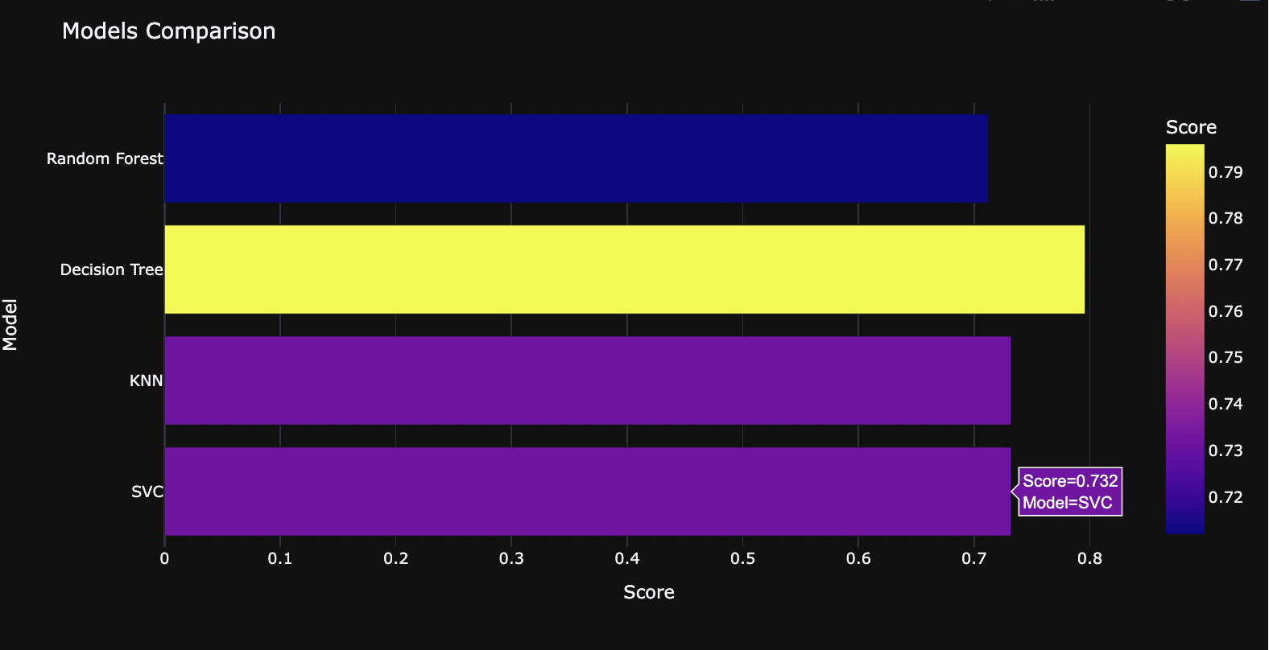
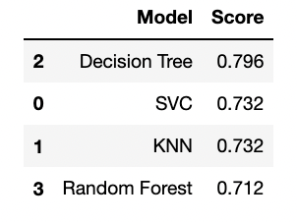
Model Selection
Decision Tree is the best model.

Slide 18
Results
Our best model is Decision Trees with an accuracy score of 0.796.
To conclude, the model was able to distinguish between fraud claims and legit claims with high accuracy.
Insurance companies can reduce investigation costs by only investigating cases that are more likely to be frauds.

Slide 19
THANK YOU!

